Slide 1
Module 4.1: Analyzing Textual Data Using Off-the-Shelf Tools
Notes:
In this lesson, we will be focusing on supporting beginner researchers in performing text analysis by using off-the-shelf, pre-built tools. It will discuss the advantages and constraints of web-based text analysis tools and programming solutions, introduce basic text analysis algorithms available in the HTRC algorithms, and demonstrate how to select, run, and view the results of the topic modeling algorithm.

Slide 2
In this module we’ll…
Weigh the benefits and drawbacks of pre-built tools for text analysis
→ Evaluate researcher questions and requests, and match tool to request
Learn how a web-based topic modeling algorithm works
→ Gain experience with off-the-shelf solutions text mining
Run the HTRC Topic Modeling algorithm and analyze the results
→ Build confidence with the outcomes of data-intensive research
See how Sam explored HTRC Algorithms for his research
→ Understand how a researcher evaluated an off-the-shelf tool
Notes:
Here is an outline of this module. We will weigh the benefits and drawbacks of pre-built tools for text analysis, learn how a topic modeling algorithm works, and run the HTRC Topic Modeling algorithm and analyze the results. We will also consider how Sam experimented with HTRC Algorithms to explore his corpus.

Slide 3
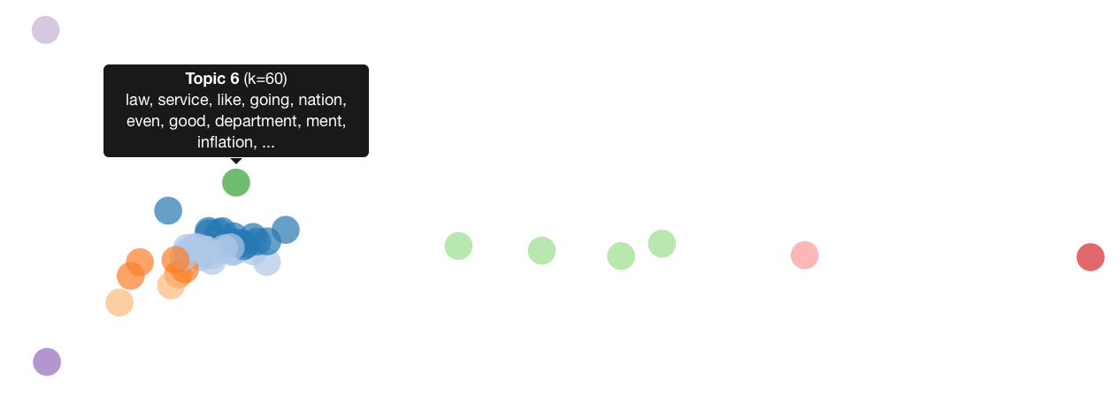
Where we’ll end up
Bubble visualization of topics created with HTRC algorithm
Notes:
By the end of this module, you will have run the HTRC Topic Modeling algorithm on a sample workset of politically-themed texts and analyzed the results.

Slide 4
Pre-built tools
Benefits
Easy to use, good for teaching
Drawbacks
Less control, limited capabilities
Examples:
Voyant, Lexos
HTRC algorithms: e.g. Topic Modeling algorithm
Notes:
For performing text analysis, there are both pre-built tools and do-it-yourself tools that you can choose from.
The benefits of pre-built tools are they are usually easy to use, they don’t require too much technical knowledge, and they can be very useful in teaching.
The main drawback of pre-built tools is because they have predefined functions, they offer less control to the researcher and limit what a user can accomplish.
Voyant, Lexos, and HTRC algorithms are examples of pre-built tools. The HTRC Topic Modeling algorithm, which identifies “topics” in a set of text based on words that have a high probability of occurring close together, is a representative HTRC algorithm that can be used for exploratory analysis. As we mentioned before, we will try using this algorithm together later in this module.

Slide 5
Do-it-yourself tools
Alternative to pre-built, off-the-shelf tools
Involve programming
Benefits:
Run on your own, allow for more parameterization and control
Drawback:
Require technical knowledge
We’ll return to this later…
Notes:
You can also use do-it-yourself tools for text analysis as an alternative, and these tools usually involve some degree of programming.
The advantages of using do-it-yourself tools are you can set your own workflows and parameters, and it allows you to have more control over what you want to do.
The drawback is they usually require technical knowledge and may be a lot harder to use.
We’ll come back to do-it-yourself options later in the workshop!

Slide 6
Choosing a pre-built tool
Depends on goal of researcher:
Quick analysis and visualizations:
Voyant
Lexos
Concordances:
AntConc
Voyant
Machine learning
WEKA Workbench aids machine learning
Notes:
Choosing a pre-built tool is based on the goal of the analysis. Each pre-built tool has its own strengths, outputs, and weaknesses.
For quick analysis and visualizations, Voyant and Lexos are all excellent choices. They don’t allow much parameterization, but they are very easy to use. To make concordances(seeing key words in context), AntConc or Voyant are tools programmed to do that. Voyant is both web-based and downloadable, so there no installation required unless desired by the researcher, while AntConc is software the user must install on their computer.
Weka is the tool to use for researchers who want to try machine learning with a tool that has a visual front-end. It also needs to be installed.

Slide 7
HTRC algorithms
Plug-and-play text analysis
Built into the HTRC interface
Mostly “as-is”
Limited parameterization
Analyze HTRC worksets
Good when you want to use HT text specifically
Notes:
For this module, we are going to use the HTRC algorithms as an example of how to use a pre-built tool for text analysis. The HTRC provides some algorithms through HTRC Analytics, and they can be used to analyze HTRC worksets.
An algorithm is just a way of saying a computer function - text goes in, process happens, and results come out.
HTRC algorithms can extract, refine, analyze, and visualize worksets. They can basically perform “plug-and-play” text analysis.
Because they are built into HTRC Analytics, they are mostly limited in how much they can be tweaked or customized. The algorithms are primarily for users who don’t know how or don’t want to work with custom code. It can be a good tool for learning and just trying things out.

Slide 8
Choosing an HTRC algorithm
Task-oriented algorithms:
Produce list of named entities
Visualize most frequently used words
Generate script for downloading Extracted Features files
Analytic algorithms:
Generate topic models
Notes:
Currently there are four HTRC algorithms available. How do you choose which HTRC algorithm to use? Naturally, it depends on what you want to do.
Most of the algorithms are task oriented. For example, there are ones for generating a list of named entities and for visualizing more frequently used words.
The algorithm that generates topic models is more analytic.

Slide 9
Key terms in text analysis
Bag-of-words
Concept where grammar and word order of the original text are disregarded and frequency is maintained.
created the four in new are ago Liberty fathers that forth continent a nation seven and conceived equal score dedicated on to years this all our men brought and proposition
Notes:
Next, we will focus on a specific text analysis method: topic modeling. One concept closely related to topic modeling is the bag-of-words model.
“Bag-of-words” is a concept where grammar and word order of the original text are disregarded and frequency is maintained. Here is an example of the beginning of The Gettysburg Address as a bag of words.

Slide 10
Key terms in context
Topic Modeling
Chunk text into documents
Documents = bags of words
Stop words are removed
Each word in each document is compared
Words that tend to occur together in documents are likely to be about the same thing
Topics are predictions of words co-occurrence
Notes:
Topic modeling is a method of using statistical models for discovering the abstract "topics" that occur in a collection of documents.
This image visualizes what happens in a topic model.
For this kind of analysis, the text is chunked, and stop words (frequently used words such as “the”, “and”, “if”) are removed since they reveal little about the substance of a text.
The computer treats the textual documents as bags of words, and guesses which words make up a “topic” based on their proximity to one another in the documents, with the idea the words that frequently co-occur are likely about the same thing.
So the different colored groupings are the groups of words that the computer has statistically analyzed and determined are likely related to each other about a “topic”.

Slide 11
Tips for topic modeling
Treat topic modeling as step in analysis
Input affects output
Number of texts analyzed, number of topics generated
Be familiar with your input data
Know that stop words can shape results
Examine results to see if they make sense
Understand the tool
Notes:
Here are some tips for topic modeling:
Treat topic modeling as one part of a larger analysis.
Understand what you input, including how you set your parameters, will affect the output. Some points to note are:
Be careful with how you set the number of texts analyzed, as well as number of topics generated
Be familiar with your input data
Know that changing your stop word list can have really interesting impacts on your topics, so tread carefully/wisely.
You’re going to want to go back to the text at some point. Make sure to examine your results to see if they make sense.
Also, try to gain some basic understanding of your tool. Reading some relevant documentation is especially important when the tool is within a “black box”. Speaking of understanding your tools, it’s important to note that the HTRC algorithm only has two parameters you can set right now, so it’s not suitable for really robust topic modeling. But for teaching and exploration of HT text specifically, the HTRC topic modeling algorithm can be a good place to start.

Slide 12
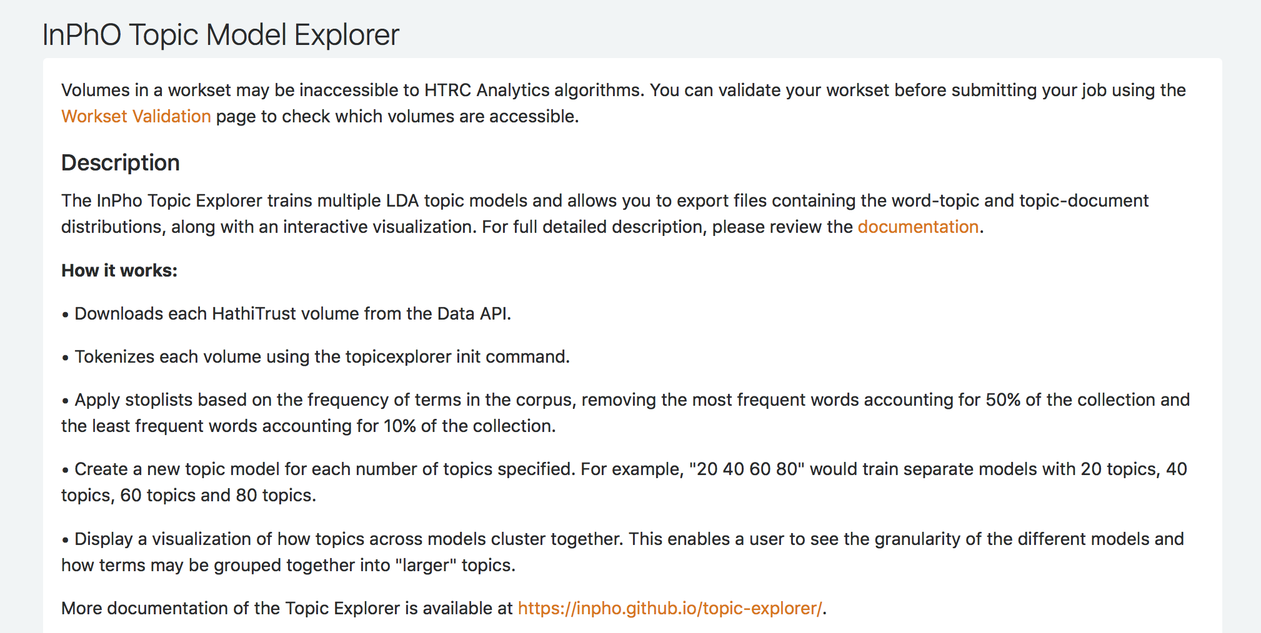
HTRC topic modeling description
https://analytics.hathitrust.org/algorithms/InPhO_Topic_Model_Explorer
Notes:
Together, let’s read the description of the HTRC topic modeling algorithm to see if we can understand what it does. The description is on the screen, or you can find it on the Algorithms page in HTRC Analytics (you will need to log in first to be able to see the page).
Downloads each HathiTrust volume from the Data API. Tokenizes each volume using the topicexplorer init command.
Apply stoplists based on the frequency of terms in the corpus, removing the most frequent words accounting for 50% of the collection and the least frequent words accounting for 10% of the collection.
Create a new topic model for each number of topics specified. For example, "20 40 60 80" would train separate models with 20 topics, 40 topics, 60 topics and 80 topics.
Display a visualization of how topics across models cluster together. This enables a user to see the granularity of the different models and how terms may be grouped together into "larger" topics.
More documentation of the Topic Explorer is available at https://inpho.github.io/topic-explorer/.
What is the stoplist removal protocol for this algorithm?

Slide 13
Hands-on activity
☞ See Handout p. 1
With a partner, each read the algorithm descriptions.
Take turns explaining what they do.
Bonus: Do you have experience with a research question well-suited to each algorithm? Describe it to your group.
Tool | What does it do? | Example research question?
Token Count and Tag Cloud Creator
Named Entity Recognizer
InPhO Topic Model Explorer
https://wiki.htrc.illinois.edu/x/HoJnAQ
Notes:
Let’s do a short activity together before moving on to the next section. In pairs or small groups, please read the descriptions for the HTRC algorithms in the chart included in the handout.
Explain to one another what each of these algorithms in the chart does. Then, can you think of the kind of research questions might they help answer? Please discuss with your partner(s) and we’ll share our ideas as a group later.
There are more algorithms with descriptions on the HTRC Algorithms Wiki page (https://wiki.htrc.illinois.edu/x/HoJnAQ ). Take a look at the descriptions of the other algorithms as well if you have time.
(Instructor organizes the activity)

Slide 14
Sample Reference Question
I’m a student in history who would like to incorporate digital methods into my research. I study American politics, and in particular I’d like to examine how concepts such as liberty change over time.
Approach: Run topic modeling algorithm to get a feel for the topics present in your workset.
Notes:
Returning to our sample reference question, let’s explore how you might use the HTRC algorithms to do this research.
One way to approach it is to run the topic modeling algorithm to see what topics are present in a body of political speech texts. We already have a sample workset of the public papers of the presidents to play with.

Slide 15
Hands-on activity
☞ See Handout pp. 2-3
In this activity you will run the topic modeling algorithm in HTRC Analytics to explore the most prevalent topics in our president public papers workset.
What You Need:
Website: https://analytics.hathitrust.org
Workset: poli_science_DDRF
Notes:
START HANDS-ON ACTIVITY
In this hands-on activity, we will run the topic modeling algorithm in HTRC Analytics to explore the most prevalent topics in our president public papers workset. We will be accessing and running the algorithm via HTRC Analytics, and will be using a sample workset already shared on the site. NOTE: see intro to workset on next slide
(Instructor may choose to demo live/go through the screenshots to introduce the entire process, and then let participants do the activity on their own.)
Overview of steps in activity:
Make sure you’re signed in to HTRC Analytics
Click “algorithms”
Note the algorithms and their descriptions
Click “Execute” under the topic modeling algorithm
Prepare to run the algorithm
Choose a workset (poli_science_DDRF)
Enter a job name
Change number of topics
Hit “submit”
Show refreshing of results page to watch the status change, point out that it can take a while to get results based on the size of the workset, complexity of the algorithm, and the load on the machine at the time. (NOTE: Now that results are being cached, this job should happen pretty quickly since this job has already been run.)
When done, click on the job name under the completed jobs
Look at the visualization of the topics
Show how results can be downloaded

Slide 16
About the political science workset
Government-published series: Public papers of the presidents of the United States
“Public Messages, Speeches, and Statements of the President”
16 volumes from U.S. presidents during the 1970s:
Jimmy Carter
Gerald Ford
Richard Nixon
We’ll use the same workset (‘poli_science_DDRF@eleanordickson’) so that we can all examine the same results!
Notes:
Before we actually run the algorithm, here’s a quick introduction to the sample political science workset we will be using in this activity.
This workset consists of a set of volumes from a government-published series, Public papers of the presidents of the United States. It contains the public messages, speeches, and statements of the President. The workset includes 16 volumes from Jimmy Carter, Gerald Ford, and Richard Nixon. We are starting with the 1970s because we were able to find volumes representing every year in that decade in the HathiTrust so it represents a relatively complete, discrete set.
In order for us to examine the same results, we will all use the same workset for this activity.

Slide 17

Using the HTRC Algorithms
☞ See Handout p. 2
https://analytics.hathitrust.org
Notes:
HANDS-ON ACTIVITY
Now, why don’t you run the topic modeling algorithm on this workset. The instructions are included in the handout, and you can work alone or with a partner. Raise your hand if you get stuck. I’ll be demoing up here if you’d like to follow along.
Current step(s) in activity:
Make sure you’re signed in to HTRC Analytics
Click “algorithms”

Slide 18
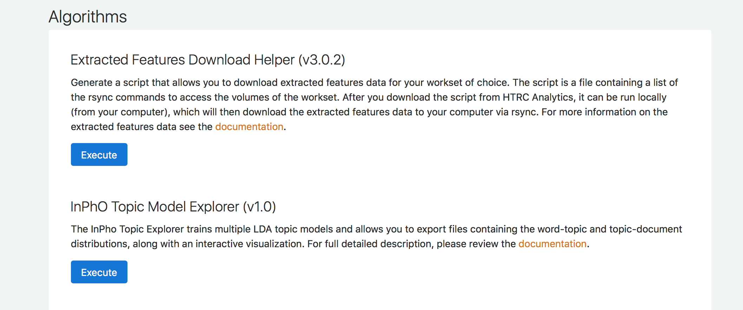
Analysis in the HTRC
☞ See Handout p. 2
Notes:
HANDS-ON ACTIVITY
For this activity, let’s click “Execute” under InPhO Topic Model Explorer (v1.0).
Current step(s) in activity:
•You’ll see the list of 4 algorithms with descriptions. Clicking execute will allow you to run your chosen algorithm on a specified workset.
•Click “Execute” under the topic modeling algorithm.

Slide 19
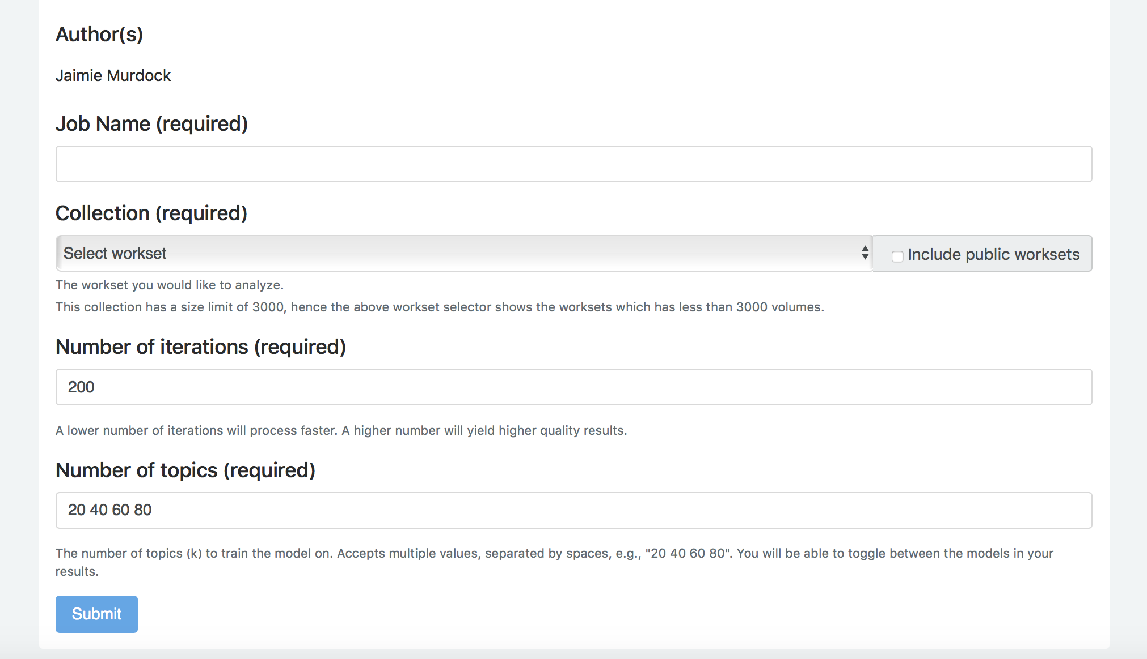
Prepare to run an algorithm
Notes:
HANDS-ON ACTIVITY
You will be brought to a page with a more detailed description of the functions of the algorithm and helps you set up the parameters according to your needs.
Current step(s) in activity:
Prepare to run the algorithm

Slide 20
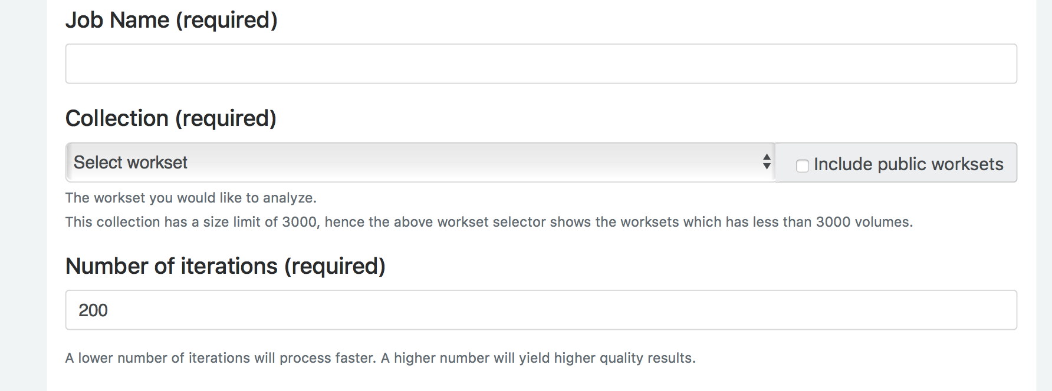
Prepare to run an algorithm
Notes:
HANDS-ON ACTIVITY
First, you will have to choose a workset to run the algorithm on. Use the drop-down menu to select from your own worksets, or check the “Include public worksets” option on the right to select from public worksets as well as your own worksets.
Current step(s) in activity:
Choose a workset (poli_science_DDRF@eleanordickson)

Slide 21
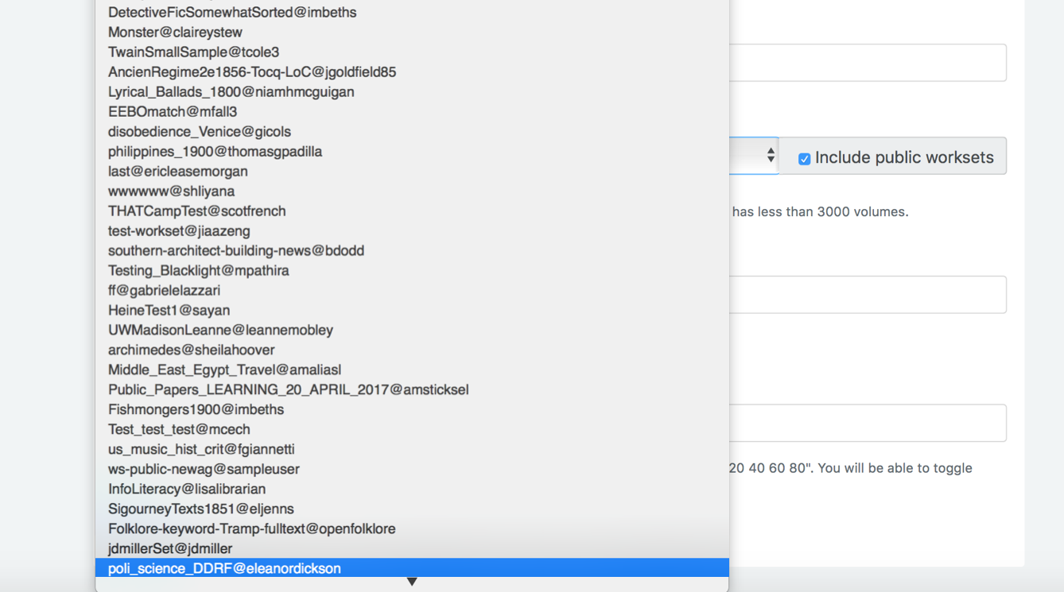
Choose workset(s) for analysis
Check box to include public worksets first
Notes:
HANDS-ON ACTIVITY
For this activity, check the “Include public worksets” option and select “poli_science_DDRF@eleanordickson”. To navigate to the workset more quickly, after clicking on the arrow button to expand the list of worksets, type “EF” and the down arrow and the workset that we need will appear at the bottom of the list.
Current step(s) in activity:
Choose a workset (poli_science_DDRF@eleanordickson)

Slide 22
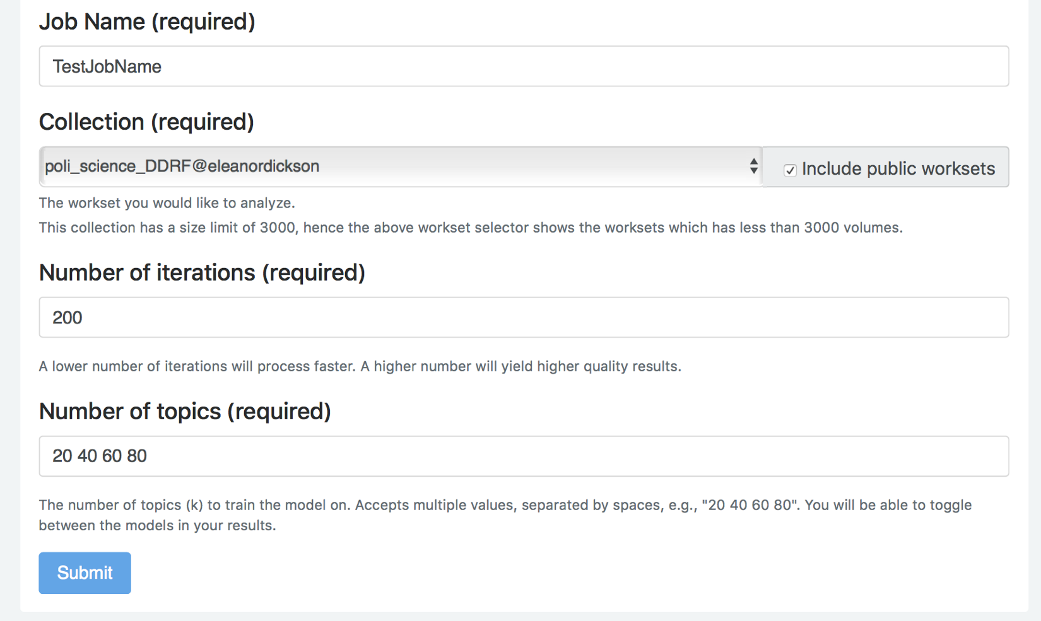
Prepare to run an algorithm
Notes:
HANDS-ON ACTIVITY
After selecting a workset for analysis, enter a job name of your choice, and this is the name that will show up later as your “Job Name” when looking at results.
Current step(s) in activity:
Enter a job name

Slide 23
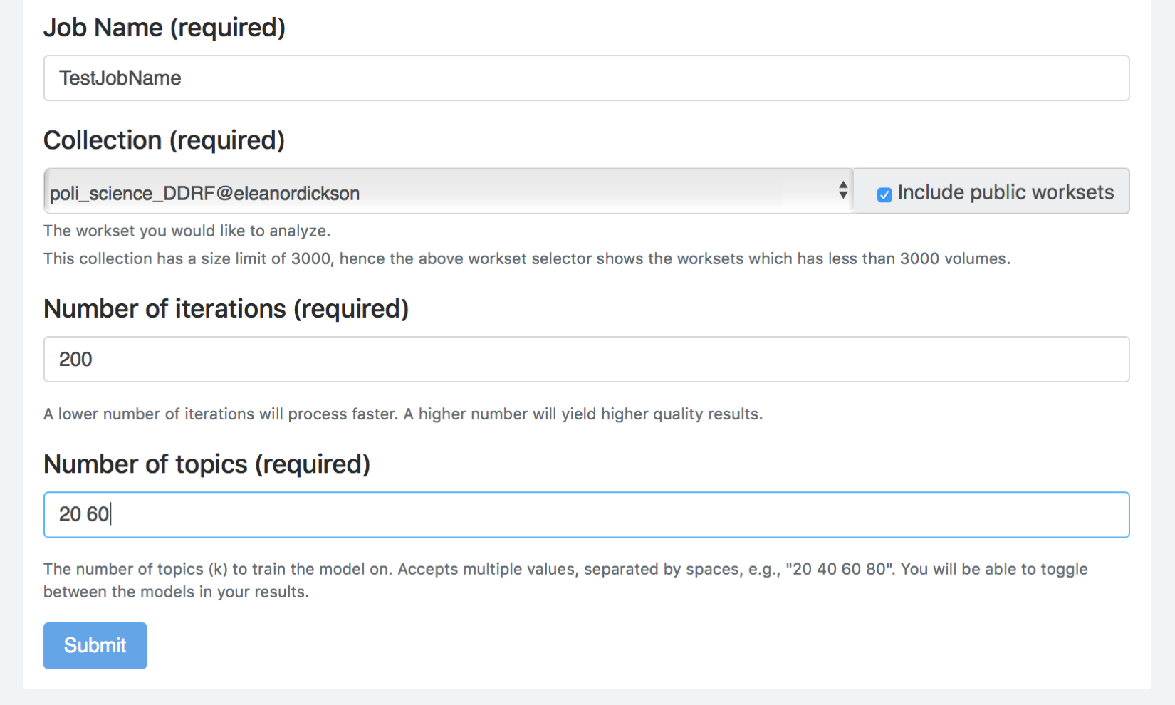
Set the number of topics
Notes:
HANDS-ON ACTIVITY
Next, we can set the number of training iterations and the number of topics to be created. Let’s keep the default setting of 200 iterations, but edit the number of topics to 20 and 60 to give us fewer results to review.
Running few training iterations will process more quickly, while running more iterations will take longer, but produce more precise results. 200 tends to be good for experimenting and 1000 is best when producing something for publication. Hit the submit button to run the algorithm.
NOTE: the topic modeling algorithm will return slightly different results each time it is run, since it is probabilistic, unless the exact same parameters are used. If an attendee gets different results than you, ensure them that their outcome is normal and use it as an opportunity to discuss what it means to do probabilistic, computational work.
Current step(s) in activity:
Change number of topics to 20 60
Hit “submit”

Slide 24
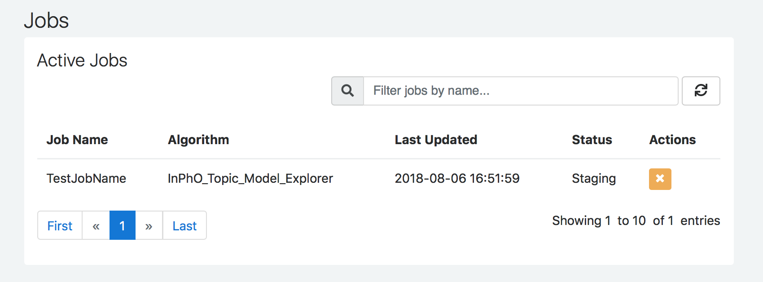
Run the analysis
Notes:
HANDS-ON ACTIVITY
Once you click the “Submit” button to start your job, you’ll be taken to a screen with your job history. You’ll see active jobs at the top. Notice that the status may change when you refresh the screen, and you’ll see your completed jobs below.
It can take a while to get results based on the size of the workset, complexity of the algorithm, and the load on the machine at the time.
(If some users cannot get their jobs processed quickly, the instructor may show the results on the screen.)
When done, the job name will move down to the Completed Jobs section.
Current step(s) in activity:
Go to jobs page.
When done, click on the job name under the completed jobs

Slide 25
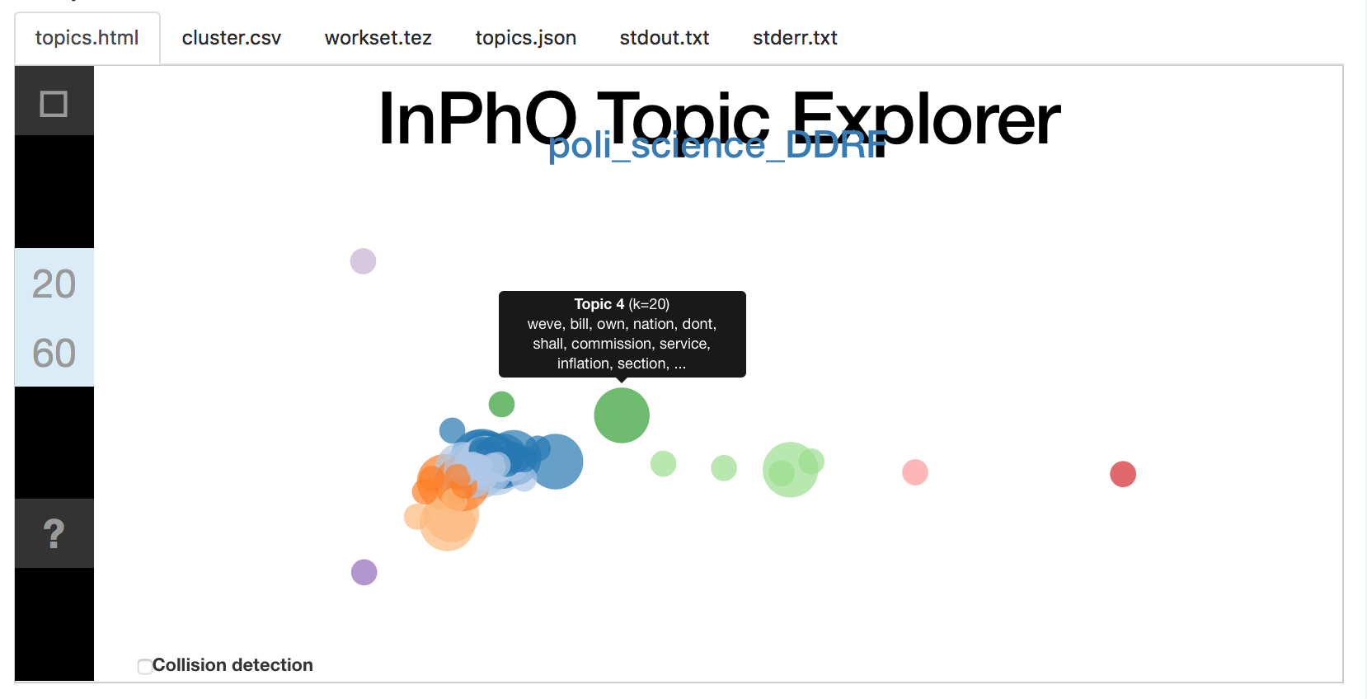
View results
Hover over bubble for top terms in topic
Check box to minimize overlap among nodes
Notes:
HANDS-ON ACTIVITY
Once the job is completed, click on the job name under the Completed Jobs section. You will be taken to a page with the results of this job.
Scroll to the “output” area, and you first will see the bubble visualization of the generated topics, showing how the topics cluster.
If you hover over a bubble, you’ll see the top terms in that topic.
The clusters and colors are determined automatically by an algorithm, and provide only a rough guide to groups of topics that have similar themes.
Checking the collision detection checkbox will minimize overlap among the nodes but distort the underlying similarity relationships.
Current step(s) in activity:
•Look at the bubble visualization of the topics
•Show how results can be downloaded

Slide 26
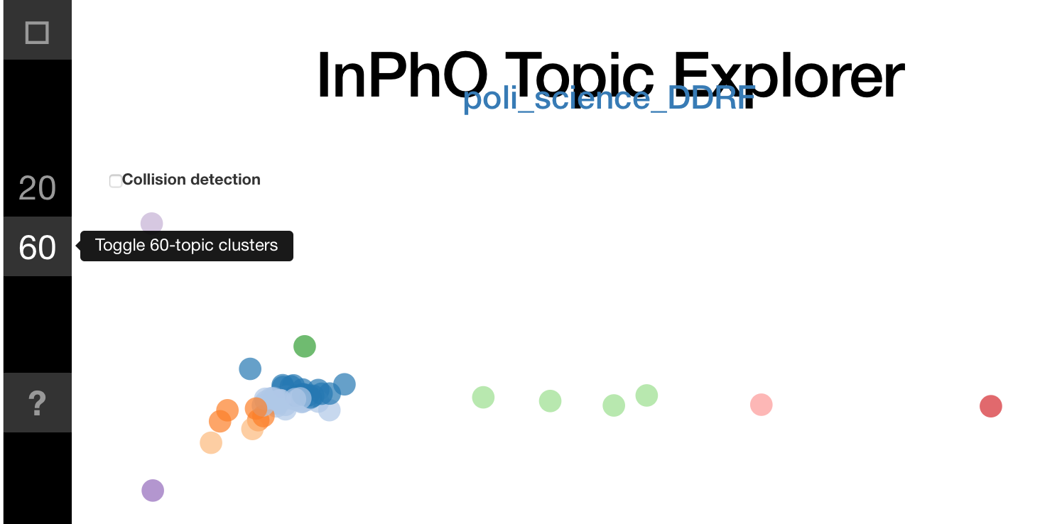
Topics visualized
Notes:
HANDS-ON ACTIVITY
These numbers on the side relate to the number of topics generated, as do the size of the bubbles. You can toggle the display of the n-topic clusters by clicking on the numbers. You’ll see that the bubbles in the 20-topic clusters are larger than the bubbles in the 60-topic clusters.
Current step(s) in activity:
•Look at the word clouds of the topic
•Show how results can be downloaded

Slide 27
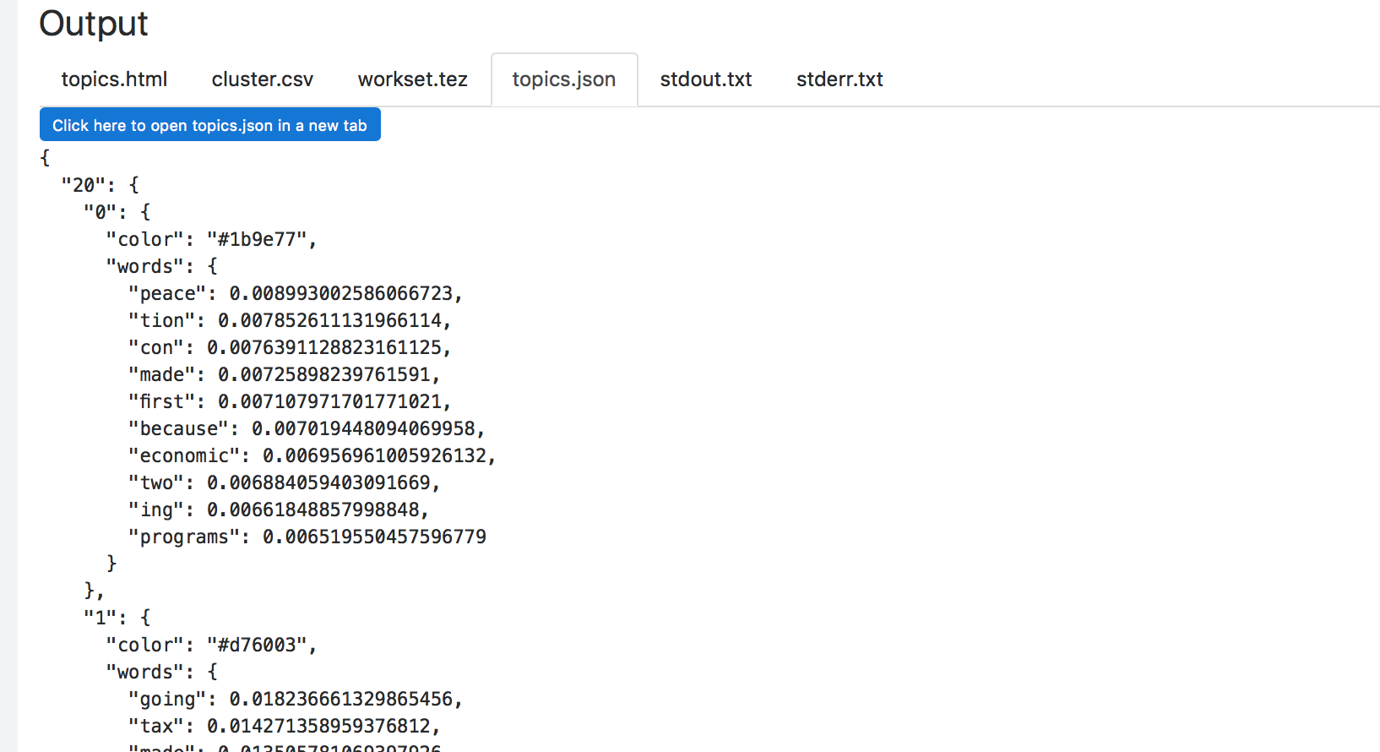
Results files
Notes:
HANDS-ON ACTIVITY
You can download 3 results files:
topics.json:
This file contains the topics for each model, the top 10 terms in each, and the term probabilities within that topic
cluster.csv:
This file contains the information that drives the visualization.
In column K, you can see which training iteration the rows refer to
The column topic shows which topic within that training iteration the row refers to
The columns orig_x, orig_y, and cluster tell the visualization how to group and display the bubbles
workset.tez: can be loaded into an instance of the InPho Topic Model Explorer on your own machine
The topic modeling tool that underlies this algorithm can also be installed and run locally.
You can feed the outputs of your HTRC algorithm into that tool if you have it installed and play with the visualization in more depth, as well as gain access to additional visualization view
More information can be found by clicking the link in the algorithm description ( https://inpho.github.io/topic-explorer/.)
Current step(s) in activity:
•Click through the tabs
•Show how results can be downloaded

Slide 28
Topics listed
Examples from 20-topics cluster:
Topic 1
nation, because, problems, under, america, security, nations, programs, con, much
Topic 2
may, such, peace, war, between, america, last, must, after, soviet
Examples from 60-topics cluster:
Topic 3
like, department, percent, said, things, office, get, assistance, programs, every
Topic 4
oil, programs, presidents, nations, cooperation, york, billion, council, kind, visit
Topic 5
problems, much, system, economy, proposed, must, each, end, case, effective
Notes:
HANDS-ON ACTIVITY
Here are some of the topics generated by the algorithm.
Some possible names for the topics:
Topic 1: National security
Topic 2: U.S.-Soviet relations
Topic 3: Administration
Topic 4: International affairs
Topic 5: Economic issues

Slide 29
Analyzing results
What would you name these topics?
Are you skeptical of any of the results?
Did you learn anything new from the topics produced?
Notes:
Let’s look at these results together. As we have mentioned before, topic modeling basically makes guesses about topics in the form of groupings of words, but it cannot directly give you what these groups of words stand for. What exactly are these topics still needs to be identified by the researcher. What would you name these topics? Are you skeptical of any of the results? Did you learn anything new from the topics produced?
Some possible names for the topics:
Topic 1: National security
Topic 2: U.S.-Soviet relations
Topic 3: Administration
Topic 4: International affairs
Topic 5: Economic issues

Slide 30
Case Study: Inside the Creativity Boom
Before making his Creativity Corpus, Sam experimented with an older version of the HTRC topic modeling algorithm
His practice HTRC workset included public domain texts from 1950 to present
Creativ* in the title
Notes:
Now, let’s return to our Creativity Boom case study by Sam. In the early stages of Sam’s research project, he experimented with HTRC algorithms, using an earlier version of the topic modeling algorithm. He had built a workset of volumes containing “creativ” in the title. Then he did topic modeling because he wanted to see what topics were prevalent in volumes related to the subject of creativity.

Slide 31

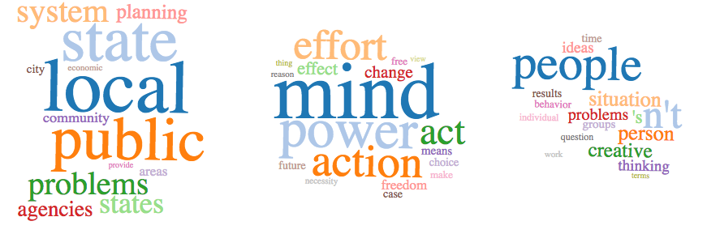


Case Study: Inside the Creativity Boom
Are these good topics?
Notes:
These are the topics that can be generated by the algorithm using Sam’s workset of volumes that contain creativ* in the title. Look at the results. Do you think they are illuminating?
We see that the dataset can affect the output in not-so-great ways.

Slide 32
Tips for topic modeling
Treat topic modeling as step in analysis
Be familiar with input text
Examine results to see if they make sense
Know that stop words can shape results
Understand the tool
Notes:
Remember our tips for topic modeling. Sam’s workset included substantial government documents. Do you think they would have skewed his results?

Slide 33
Case Study: Inside the Creativity Boom
Sam ended up using HTRC Extracted Features to get the data needed to analyze contemporary material
The fits and starts of his project are a great real-world example!
Notes:
Because Sam wanted to explore 20th century (i.e. predominately in-copyright) volumes, he applied for an HTRC ACS award that allowed him to have assistance analyzing otherwise (at that point) restricted text.
Sam’s false start with his public domain corpus and topic modeling exploration are great real-world examples of the non-linear research process. Using the web-based algorithm, he was able to quickly discern there was an issue with his workset. This realization allowed him to move on to other options.

Slide 34
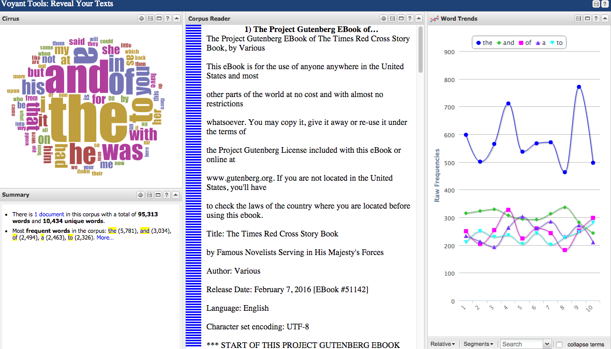
Other pre-built tools
Depends on your goal for analysis:
Voyant: easy to use, good for instruction
Lexos: text cleaning, visualizations
AntConc: good for concordances
WEKA Workbench: aids machine learning
HTRC algorithms: good for using HT text specifically
Voyant dashboard
Notes:
Again, remember that there are a host of pre-built tools that you can use for text analysis. Here are some we mentioned before :
Voyant is very easy to use, it’s flexible in the kinds of files that can be examined, and it is excellent for teaching
Lexos has nice text cleaning capabilities and can also produce nice visualizations like word clouds
AntConc is recommended for building concordances The WEKA workbench is a downloadable tool that assists with machine learning
HTRC Algorithms are good for when a researcher wants to analyze text from the HT corpus specifically, and they are suited for quick analysis or teaching

Slide 35
Discussion
To what kinds of researchers on your campus would you recommend pre-built text analysis tools?
Do you have any techniques for introducing these tools that have worked well in the past?
If you have not taught digital scholarship tools, what techniques appeal most to you at this point?
Notes:
Before we end this session, let’s have a short discussion about digital scholarship in an educational or research setting. Do you teach digital scholarship tools to students and researchers? What aspects do you find challenging? What techniques have worked for you in the past? If you have not taught digital scholarship tools, what techniques appeal most to you at this point?
(This is should be a small group discussion for 5-10 minutes)

Slide 36
Questions?
Notes:
That’s all we have for this lesson, and we will be happy to take any questions from you.

Slide 37
References
Blei, D. M. (2012). Probabilistic topic models. Commun. ACM 55, 4 (April 2012), 77-84. http://dx.doi.org/10.1145/2133806.2133826.
Notes:
(Show references so attendees know where to find them later.)

